Slide 1
Comparative Analysis Of Depreciation Methods
Straight-Line vs. Diminishing Balance
Bonam Pooja
Coachx Batch - 112

Slide 2
Introduction
What is Depreciation ?
Depreciation is the systematic allocation of the cost of a tangible asset over its useful life. It reflects the reduction in value of an asset as it is used over time.
Scope
The scope of this comparative analysis includes understanding the key differences between the Straight-Line and Diminishing Balance methods of depreciation. This analysis will help determine which method is more suitable under different circumstances, considering factors like asset cost, additional costs, asset lifespan, and salvage value.

Slide 3
Importance of Depreciation in Accounting:
Depreciation helps in matching the cost of the asset with the revenue it generates. It provides a method to allocate the cost of the asset over its useful life, impacting both the income statement and the balance sheet. Depreciation also helps in tax deduction, as it is considered an expense.
Terminologies
Asset Cost: The initial cost of the asset.
Additional Asset Cost: Any additional costs incurred in acquiring the asset, such as transportation, installation, and setup costs.
Asset Price: The total cost of the asset, including any additional costs.
Scrap Value: The estimated residual or salvage value of the asset at the end of its useful life.
Estimated Life Span (Years): The expected number of years over which the asset will be depreciated.

Slide 4
Depreciation/Year as per Straight Line Method: The amount of depreciation allocated to each year of the asset's useful life, calculated as (Asset Price - Scrap Value) / Estimated Life Span.
Depreciation Percentage: The annual depreciation rate, calculated as (Depreciation/Year as per Straight Line Method) / Asset Price.
Total Depreciation For Its Life Span: The total depreciation expense over the asset's entire useful life, calculated as (Depreciation/Year as per Straight Line Method) * Estimated Life Span.
Depreciated Book Value After Its Life Span: The value of the asset after it has been fully depreciated, equal to the scrap value.
Balance Amount: Any remaining balance after fully depreciating the asset, which should ideally be zero.
Rate of Depreciation as per Diminishing Balance Method: The annual depreciation rate calculated based on the diminishing balance method.
Depreciation Schedule: A table showing the year-by-year depreciation amounts and the corresponding book values of the asset.

Slide 5
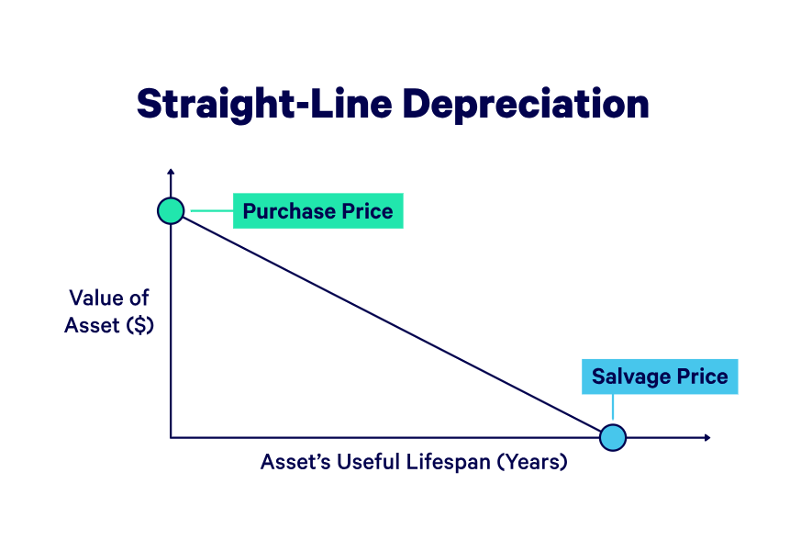
What is Straight Line Depreciation?
With the straight-line depreciation method, the value of an asset is reduced uniformly over each period until it reaches its salvage value. Straight line depreciation is the most commonly used and straightforward depreciation method for allocating the cost of a capital asset.
It is calculated by simply dividing the cost of an asset, less its salvage value, by the useful life of the asset.

Slide 6
Straight Line Depreciation Formula
The straight-line depreciation formula for an asset is as follows:
Depreciation per year = (Asset Price - Scrap Value) / Estimated Life Span.
Where:
Asset Price is the purchase price of the asset
Scrap Value is the value of the asset at the end of its useful life
Estimated life span represents the number of periods/years in which the asset is expected to be used by the company

Slide 7
Merits
The merits of using the Straight-Line Method to calculate depreciation are as follows:
It is the easiest method to compute the depreciation of an asset.
The Straight-Line Method can reduce the Asset value to Zero or Net Scrap Value by following this method.
The total amount to be charged under this expense is easy to calculate by multiplying the yearly depreciation by the number of years of the asset’s usage.
There is uniformity in terms of the depreciation amount. This amount gets reduced from the Profit and Loss Account on an annual basis.
This method is helpful for assets of smaller value.
Comparison of profits between years becomes more straightforward because the depreciation amount charged remains the same every year.
This method of calculating depreciation is best for assets under regular use to determine their expected life.

Slide 8
Demerits
The demerits of using the Straight-Line Method to calculate depreciation are as follows:
The asset bears more repairs and maintenance charges in the final years of its life than the initial years. But since the depreciation charge is equal for all years, it puts undue pressure on the asset.
There is no provision to replace the asset under the Straight-Line Method and it is up to the firm to arrange funds for that purpose.
The decision to depreciate the asset on its original cost is not prudent when its value declines every year.
This method is not helpful for assets where additions and expansions like plants, machinery, or buildings are possible.

Slide 9
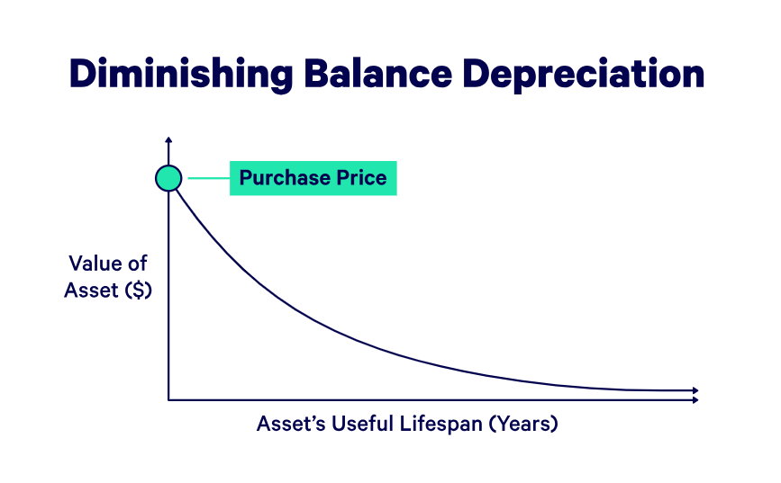
What is Diminishing balance method ?
According to the Diminishing Balance Method, depreciation is charged at a fixed percentage on the book value of the asset. As the book value reduces every year, it is also known as the Reducing Balance Method or Written-down Value Method. Since the book value reduces every year, hence the amount of depreciation also reduces every year. Under this method, the value of the asset never reduces to zero.
When the amount of depreciation charged under this method and the corresponding period are plotted on a graph it results in a line moving downwards.

Slide 10
Diminishing Balance Method Formula:
The Diminishing balance method formula for an asset is as follows:
Depreciation per year = Book Value at Beginning of Year * Depreciation Rate
Step 1: Calculate the depreciation expense using the following formula:
Depreciation Value: (Net Book Value - Scrap Value) * Depreciation Rate
Step 2: Subtract the depreciation cost from the asset’s current book value to determine the remaining book
value of an asset.
These two steps are repeatedly used throughout the asset's useful life. In the final year of the asset's useful life, you should subtract the residual value from the current book value and record the amount of depreciation.

Slide 11
Merits
The merits of using the Diminishing balance Method to calculate depreciation are as follows:
The calculation of depreciation amount using the diminishing balance method is quite easy. It does not require any special knowledge to calculate the depreciation expense using this method.
This method of calculating depreciation is applicable for valuable assets like buildings, plants and machinery, equipment, etc. having a long life.
In this method, a higher amount of depreciation is deducted in the initial years. So, it helps to minimize the impact of obsolescence of assets.
The diminishing balance method of depreciation is acceptable by tax authorities. Hence, it provides tax benefits to the company.
Diminishing balance method balances the yearly burden on the profit and loss account in terms of both depreciation and repairs. The depreciation amount continues to decline while the expenses on repairs continues to increase. Hence the total expense against revenue over different years remains more or less the same.

Slide 12
Demerits
The demerits of using the Diminishing balance Method to calculate depreciation are as follows:
It is quite tedious to estimate the appropriate rate of depreciation.
The asset value cannot be brought down to zero.
As depreciation cost is high initially, it results in lower net income during the initial period.
Depreciation is neither based on the asset value nor evenly distributed throughout the useful life of an asset.
It is not an ideal method for the assets like Plant and Machinery as these assets do not lose their value easily.

Slide 13
Difference Between Straight Line and Diminishing Balance Method
Basis | Straight Line Method | Diminishing Balance Method
Meaning | Under this method of charging depreciation, the amount charged as depreciation for any asset is fixed and equal for every year. | Under this method of charging depreciation, the amount charged as depreciation for any asset is charged at a fixed rate but on the reducing value of the asset every year.
Depreciation Charged | Depreciation is calculated on the original cost of the asset. | Depreciation is calculated on the written-down value of the asset.
Amount of Depreciation | The amount of depreciation charged is the same for every year. | The amount of depreciation charged is different for every year. It is higher in the initial year and gradually decreases.
Value of Asset | The value of an asset under this method is completely written off. | The value of an asset under this method is not completely written off.
Burden | Under this method, the cost of maintenance increases year by year, adding to the increased burden on the company as depreciation is also fixed for every year. | Under this method, the cost of maintenance increases year by year, but depreciation decreases in later years. Because of this, the burden on the company is more or less the same throughout the year.
Tax Purpose | This method is not recognized by the Income Tax Department, and therefore, it is not applicable for Income Tax purposes. | This method is recognized by the Income Tax Department, and therefore, it is applicable for Income Tax purposes.

Slide 14
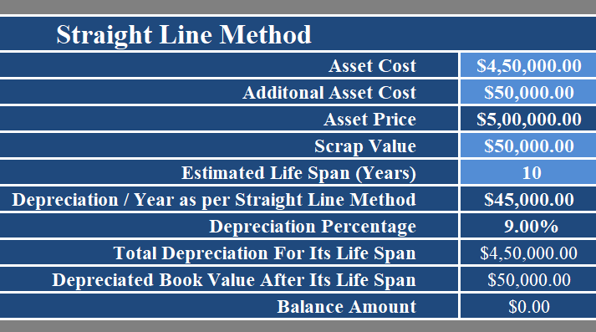
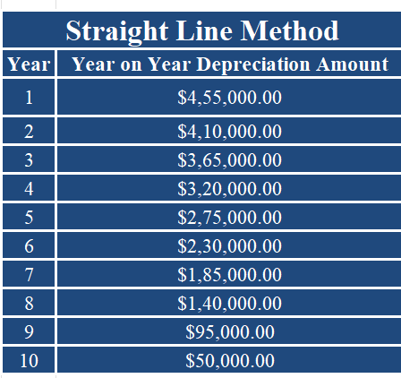
Straight-Line Method
Example Calculation:
Suppose an asset costs $5,00,000 with a scrap value of $50,000 and an estimated life span of 10 years. The annual depreciation would be ($5,00,000 - $50,000) / 10 = $45,000.

Slide 15
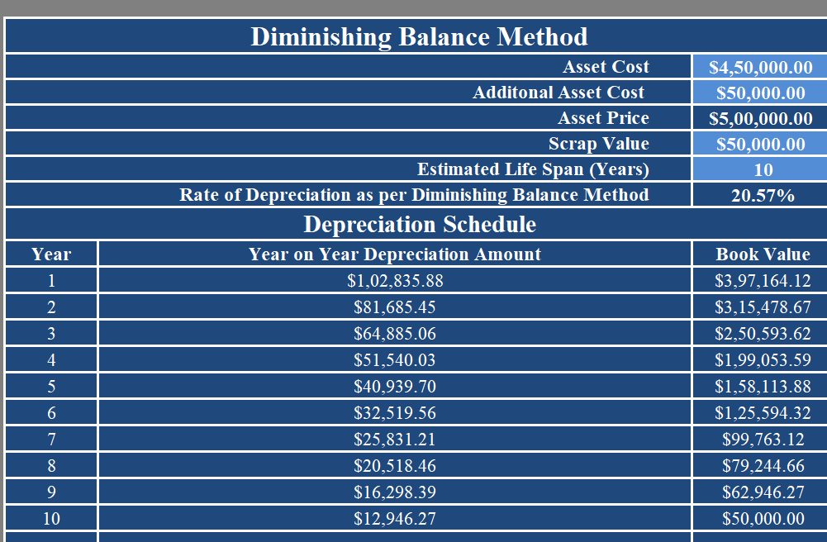
Diminishing balance method
Example Calculation:
Suppose an asset costs $5,00,000 with a depreciation rate of 20.57%. The first year's depreciation would be $5,00,000 * 20.57 = $1,02,835.88, and the book value at the end of the first year would be $5,00,000 - $1,02,835.88 = $3,97,164.12. The second year's depreciation would be $3,97,164.12 * 20.57 = $81,685.45, and so on.

Slide 16
Comparative Analysis of Both Methods:
The Straight-Line method provides a consistent annual depreciation expense, which is simple to calculate and understand. It is suitable for assets that provide consistent utility over time.
The Diminishing Balance method provides higher depreciation expense in the earlier years and lower expense in the later years. It is suitable for assets that lose value quickly or become obsolete faster.

Slide 17
Conclusion
Summary of Findings:
Both methods have their own merits and are suitable for different types of assets and business scenarios. The choice of method depends on the nature of the asset and the business's financial strategy.
Recommendations:
For assets that provide consistent utility over time, the Straight- Line method is recommended due to its simplicity and uniform expense allocation. For assets that lose value quickly or become obsolete faster, the Diminishing Balance method is recommended to better match expense with asset usage.

